Slide 1
ASP.NET Core & EF Core INTRO, FEATURES & HIGHLIGHTS
Halil İbrahim Kalkan

Slide 2
Agenda
About Me & My Projects
.Net Standard vs .Net Core vs .Net Framework
ASP.NET Core, Overall
ASP.NET Core, MVC
Entity Framework Core
Demo: Integration Testing
Final Words & Decisions

Slide 3


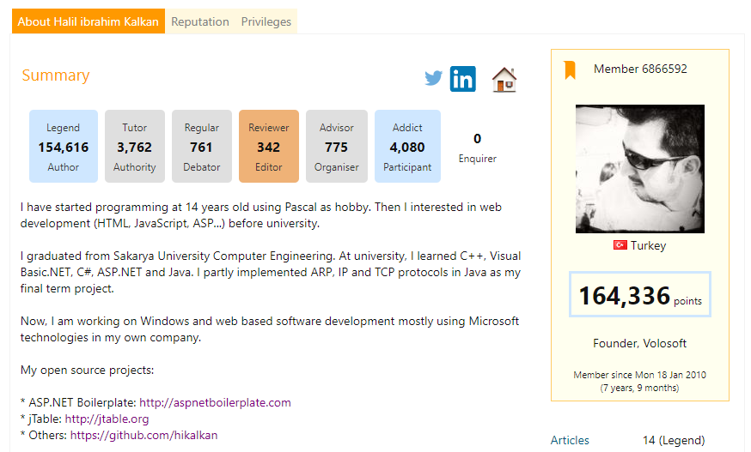
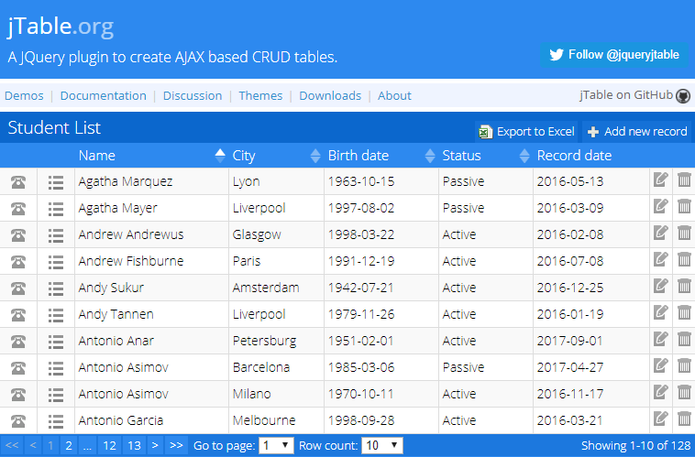

About Me & My Projects
https://github.com/hikalkan
https://www.codeproject.com/members/hi_kalkan
http://jtable.org/

Slide 4

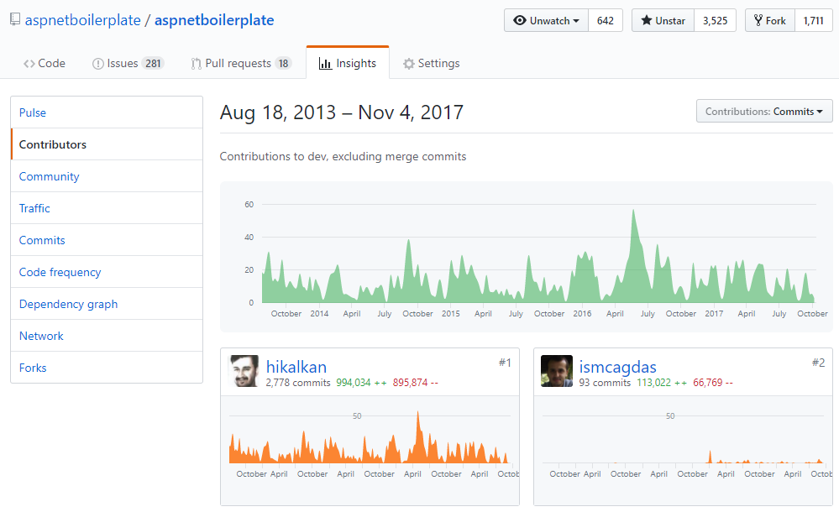
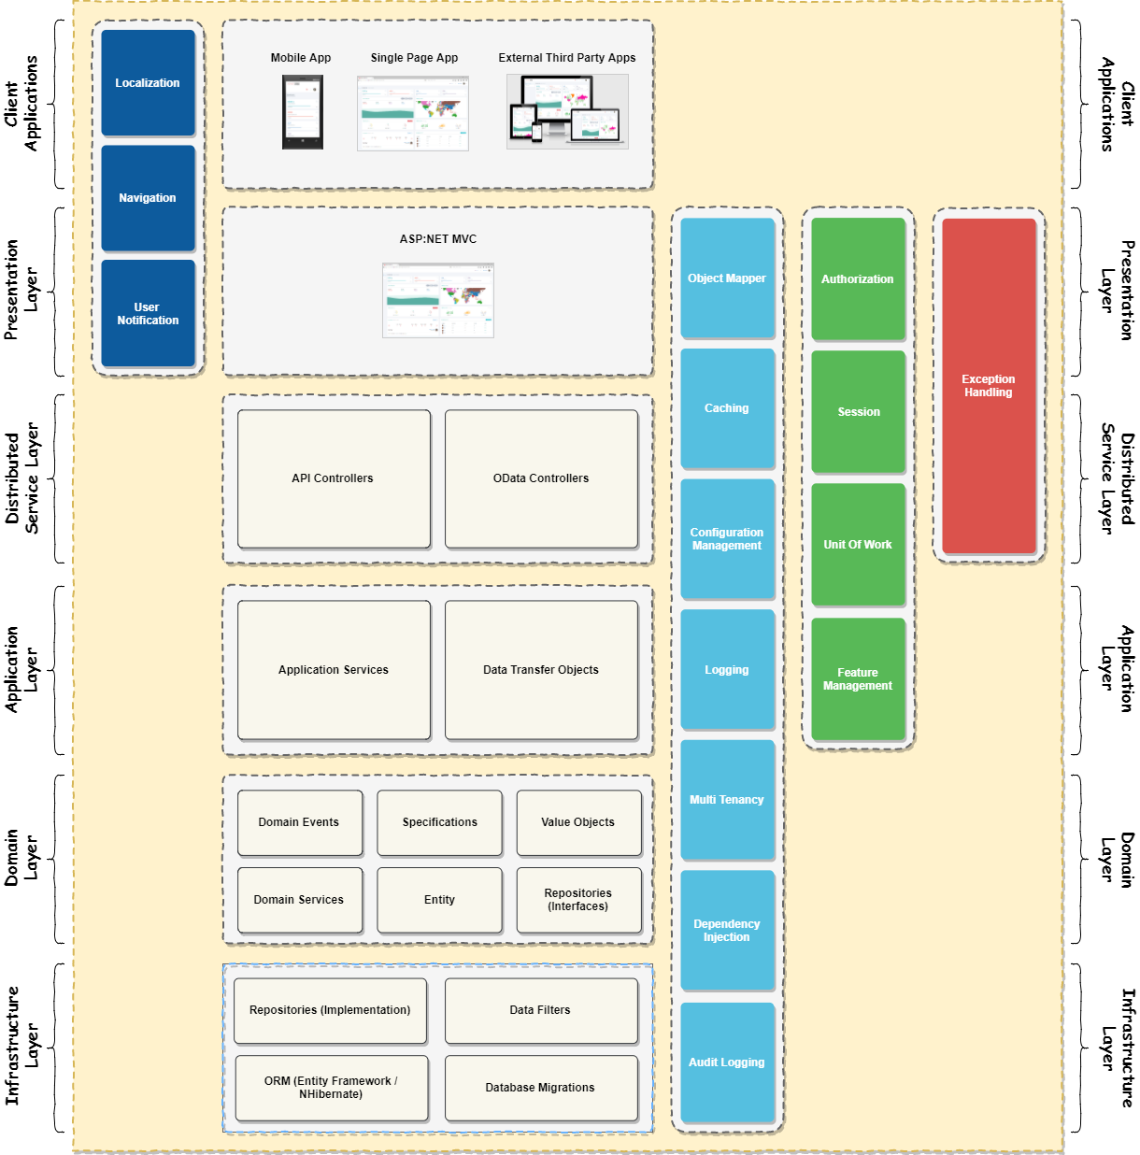
https://aspnetboilerplate.com
Layered & Modular Architecture
Multi Tenancy / SaaS infrastructure
Domain Driven Design
Exception handling, Caching, Audit logging, Validation, Authorization, Localization, Logging, Security…
Db Connection & Transaction Management, Setting Management, Event Bus, Real Time Notifications, Dynamic API & Proxying…

Slide 5

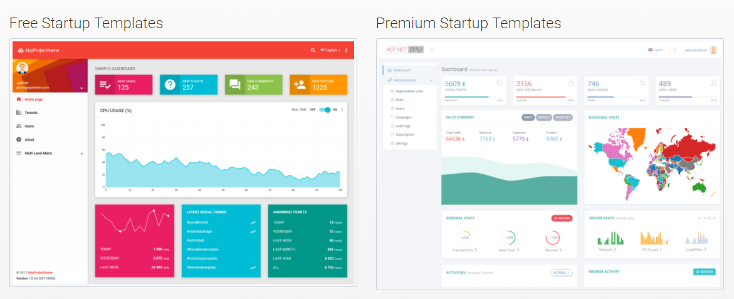
aspnetboilerplate.com
aspnetzero.com

Slide 6
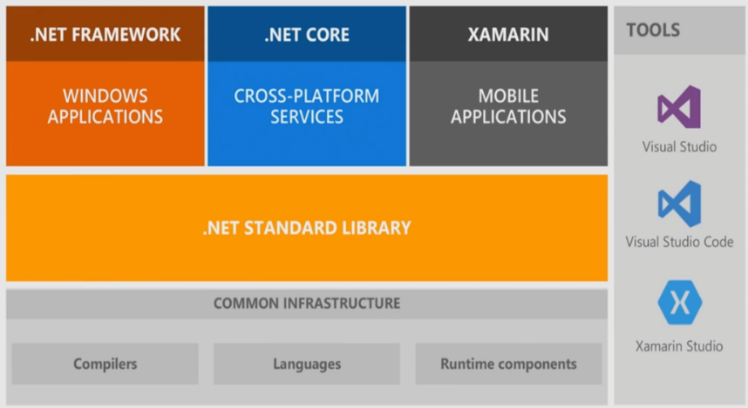
.Net Standard vs .Net Core vs .Net Framework
.Net Core
Open Source
Cross Platform
ASP.NET Core
Modern, Lightweight, Componentized Architecture
High-performance, Microservice-Focused!
Unified Web Stack (MVC UI + Web API)
Extensible
Testable
Others
Entity Framework Core
ASP.NET Core Identity
IdentityServer4

Slide 7
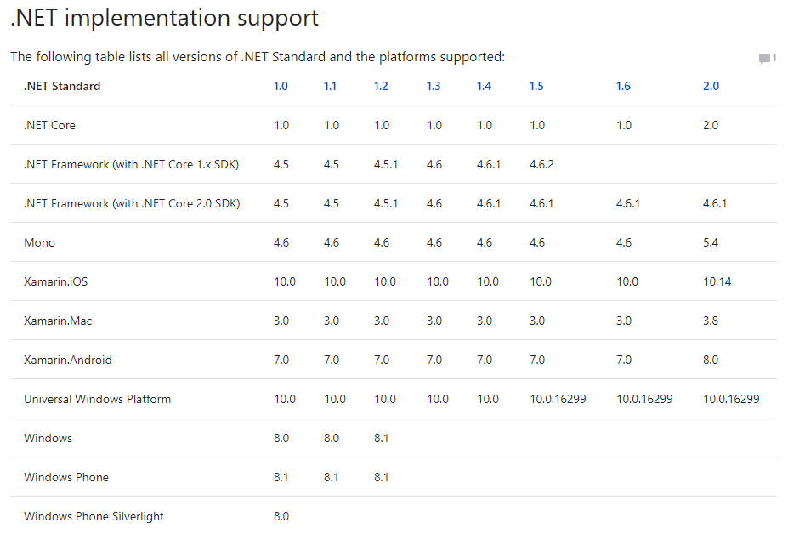
.Net Standard Support

Slide 8
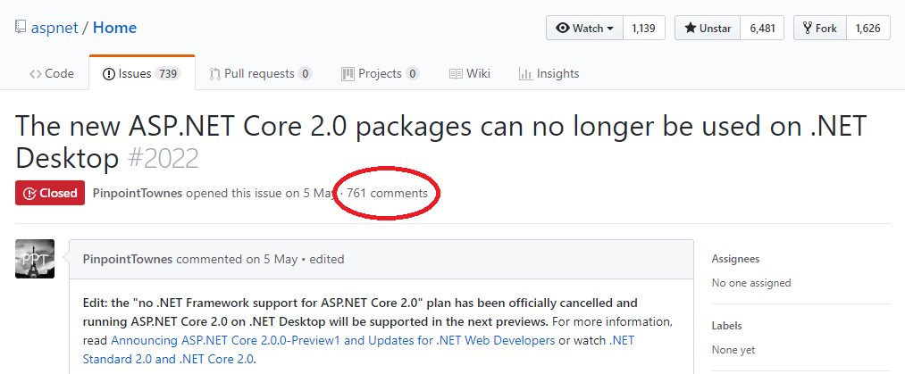
ASP.NET Core
Runs on .Net Core 2.0 & .Net Framework 4.6.1. (.netstandard2.0)

Slide 9
Microsoft.Extensions.* Libraries
Independent from ASP.NET Core!
Dependency Injection (and 3rd-party adapters)
Castle Windsor: https://github.com/volosoft/castle-windsor-ms-adapter
Configuration Management (appsettings.json and more)
Logging
Caching
Localization
User Secrets
Dotnet CLI

Slide 10
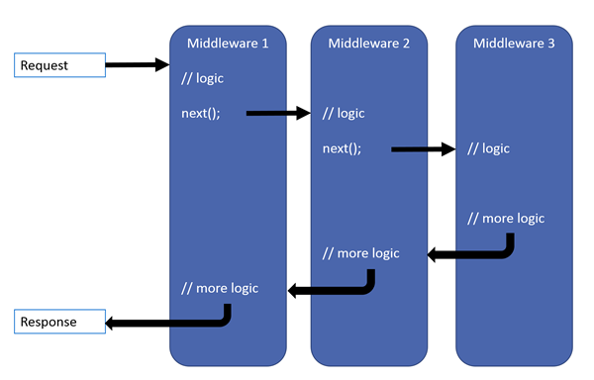
ASP.NET Core Middleware Pipeline
Some Common Middlewares
Authentication
Request Localization
Exception Page
Static Files
MVC

Slide 11
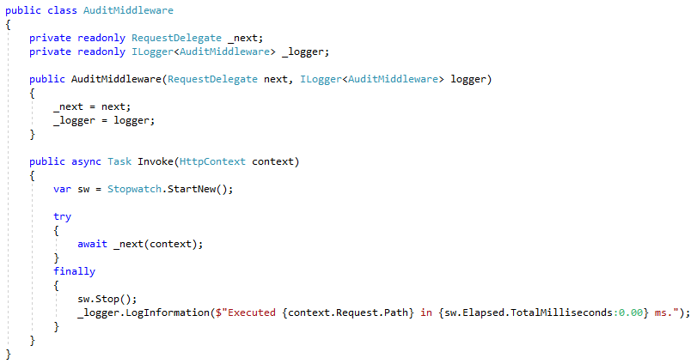
ASP.NET Core Simple Middleware

Slide 12
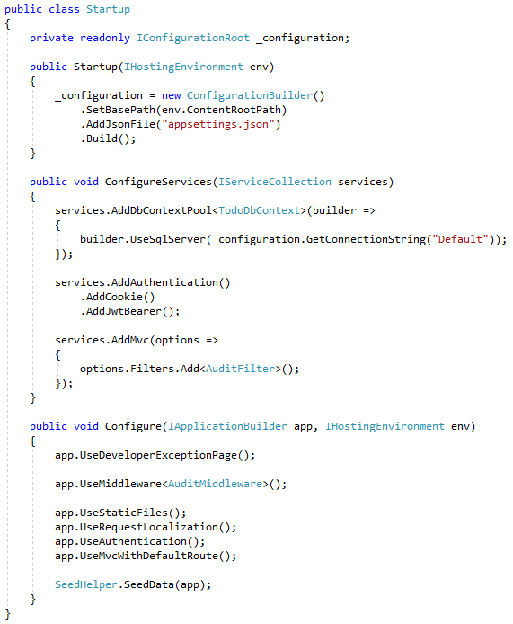
ASP.NET Core Startup Class
Register Dependencies and set options
Add Middlewares
Initialize Application
No more
Global.Asax / System.Web
Web.Config

Slide 13
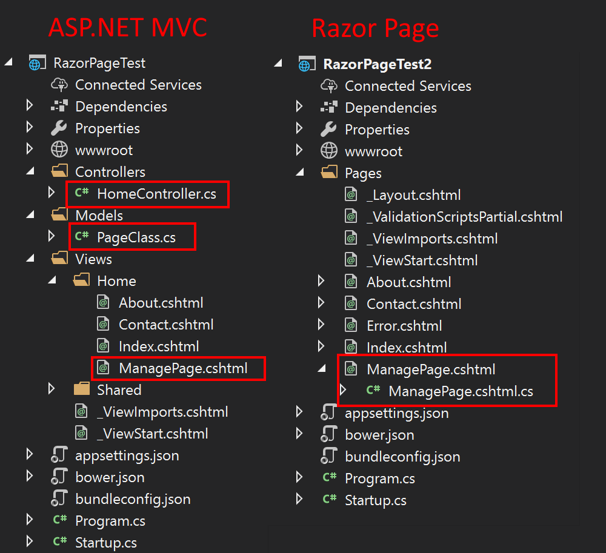
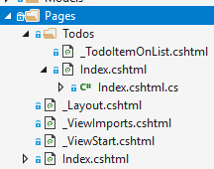
ASP.NET Core MVC Razor Pages
No more MVC!
Razor Pages -> UI (recommended & default)
Controllers (without View) -> (REST) API
New Pages folder (and folder hierarchy)

Slide 14
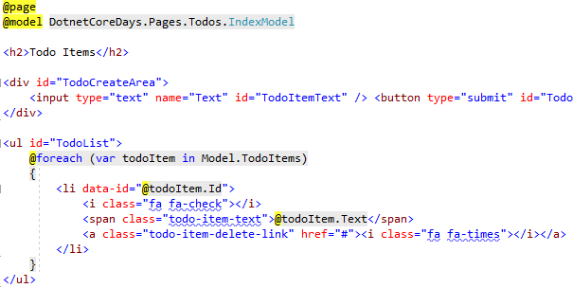
ASP.NET Core MVC Razor Pages
New @page directive
Full Razor Support
@model directive
Layout.cshtml
_ViewStart.cshtml
_ViewImports.cshtml
Partial Views
Sections
…

Slide 15
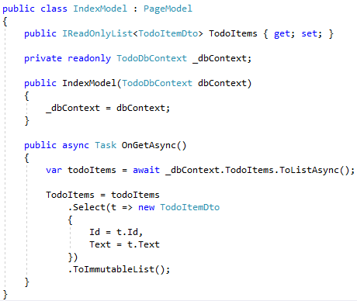
ASP.NET Core MVC Razor Pages
Inherits from PageModel
OnGetAsync is to respond HTTP GET method, OnPostAsync is for POST by default.
Dependency Injection works as expected
Public properties are accessible from Razor UI

Slide 16
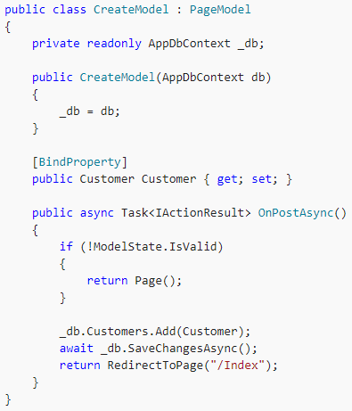
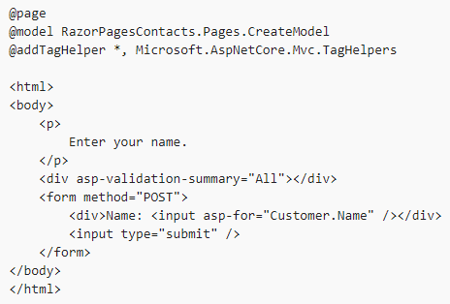
ASP.NET Core MVC Razor Pages > BindProperty

Slide 17
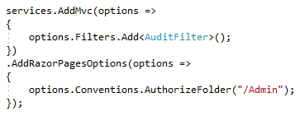
ASP.NET Core MVC Razor Pages > Other Features
Authorization
TempData (share data between requests! Uses Cookie by default)
Supports Exception Filters and Result Filters
Does not support Action Filters yet (planned for v2.1)

Slide 18


ASP.NET Core MVC Other v2.0 Features
Unified Authentication Middleware
New Microsoft.AspNetCore.All package
Automatic page & view compilation on publish (default)
Automatic use of antiforgery tokens
Razor support for C# 7.1

Slide 19

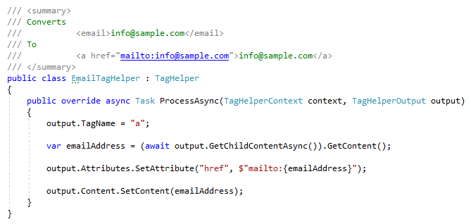
ASP.NET Core MVC Tag Helpers
Define new tags, attributes
Manipulate rendering of HTML elements
Remove elements from output conditionally
Add surrounding/inner elements

Slide 20
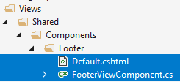
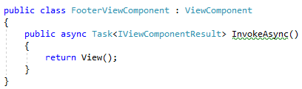

ASP.NET Core MVC View Components
Child Actions removed
Introduced View Components
Similar to partial views with it’s own action
Can be used like tag helpers (with vc: prefix) or with Component.Invoke method

Slide 21
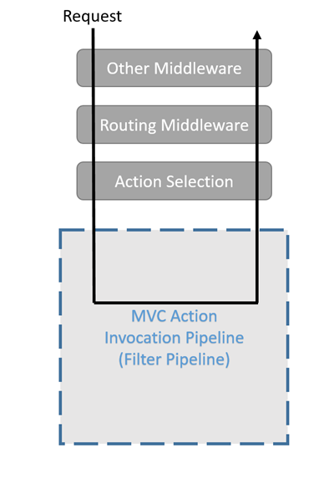
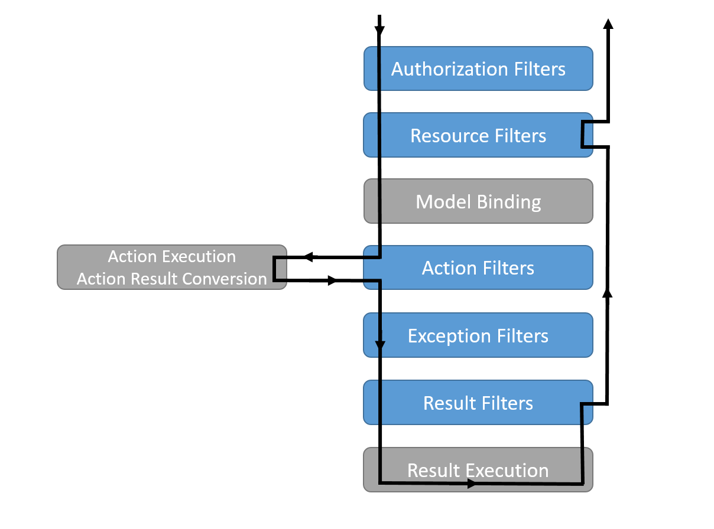
ASP.NET Core MVC Action Filters

Slide 22
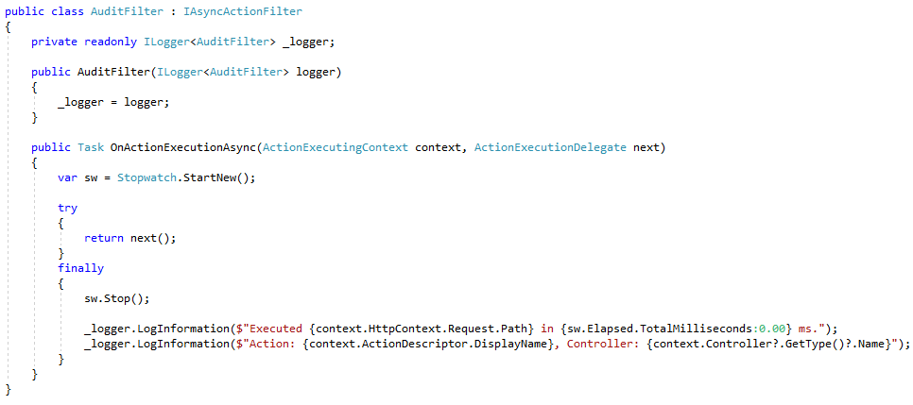
ASP.NET Core MVC Action Filters

Slide 23
ASP.NET Core MVC Client Side Development
Client-side package management..?
Npm, Bower
Bundling, Minification..?
Bundler & Minifier Visual Studio Extension
Web Compiler Visual Studio Extension
Gulp/Grunt

Slide 24
ASP.NET Core Other frameworks / libraries
ASP.NET Core Identity for membership system
ASP.NET Core SignalR for real-time server-client communication (alpha stage)
Identity Server 4 to create Oauth / OpenId Connect server
ASP.NET Boilerplate as application framework and architectural model :)

Slide 25
Entity Framework Core
Developed from scratch, optimized for cloud!
Compared to EF 6.x
Lightweight, better performance
Cleaner SQL output
Better testability (supports in-memory database out of the box)
Missing features
Lazy load (instead, use explicit load)
Database first (probably will never support)
Seed data
TPT & TPC inheritance
Lifecycle hooks/events

Slide 26
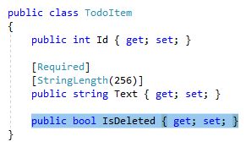
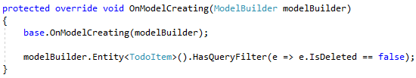
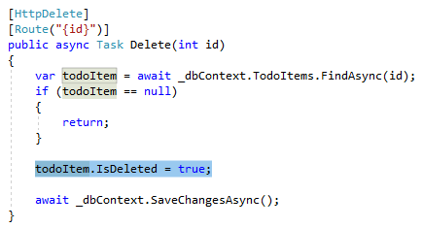
Entity Framework Core Global Query Filters
Automatically filter data by an arbitrary condition
Common usages:
Soft-delete / Active-passive entities
Multi-tenancy
Missing features / limitations
Limited filter enable/disable out of the box
Does not support multiple filter expressions (need to combine multiple filters in a single expression)
Filters can only be defined on the root Entity Type of a hierarchy

Slide 27

Entity Framework Core Other v2.0 features
DbContext Pooling
Table Splitting (multiple entities share same table)
Owned types (can be used for complex types)

Slide 28
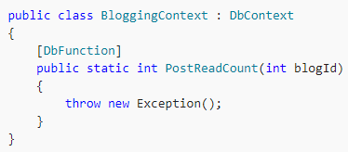

Entity Framework Core Other v2.0 features
Database scalar function mapping
Explicitly compiled queries

Slide 29
DEMO - Integration Testing
Using the following tools:
ASP.NET Core as web framework
Entity Framework Core as ORM
with SQLite in-memory database
xUnit as test framework
Shoudly as assertion library
AngleSharp as HTML parser
Source code: https://github.com/hikalkan/presentations

Slide 30



Final Words & Decisions
ASP.NET Core MVC or ASP.NET MVC 5.x..?
.net core or .net framework..?
Entity Framework Core or Entity Framework 6.x..?
Multi-Page Application or Single-Page Application..?
Server-Rendered HTML or Client-Rendered HTML..!
halilibrahimkalkan.com
hikalkan
hibrahimkalkan

